Slide 1



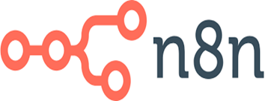
No-code/low-code software development course
COURSE AGENDA:
Master the power to create apps and automate processes—without coding through No-Code/Low-Code training.
Use 4 no-code tools like Zapier, n8n, Bubble, and Webflow to transform ideas into working digital solutions quickly.
Boost your career or startup potential with future-ready, creative, and automation-driven skills.
Develop Workflows , Perform Automations , Execute Integrations, Connect 10,000+ online data sources
About Instructor:
Shahzad - Software Fractional Strategy Consultant
About Institute:
NexSkill is Pakistan's leading IT training institute, providing the best IT training in Pakistan. NexSkill offers a variety of professional learning platforms to its students.
https://www.nexskill.com/

Slide 2

Let’s Define – BIG Picture
What is WorkFlow? [In terms of Software]
A workflow is a system for managing repetitive processes and tasks which occur in a particular order. They are the mechanism by which people and enterprises accomplish their work, whether manufacturing a product, providing a service, processing information or any other value-generating activity.
References:
https://www.ibm.com/think/topics/workflow
https://asana.com/resources/workflow-examples
https://www.geeksforgeeks.org/software-engineering/what-is-workflow/
https://www.techtarget.com/searchcio/definition/workflow
What is Integration? [In terms of Software]
Software integration is the process of connecting different software parts or applications to enable seamless data sharing without manual intervention. This process involves a central hub that collects and processes data, distributing it among the applications that need it to perform their tasks. Software integration can connect different parts of the same software or different system platforms to share metrics and data.
References:
https://www.ibm.com/think/topics/application-integration
https://www.snaplogic.com/glossary/software-integration
https://www.workato.com/the-connector/software-integration/
What is Automation? [In terms of Software]
Automation is the application of technology, programs, robotics or processes to achieve outcomes with minimal human input.
The term "Automation" was first used in 1946 by General Motors to describe the automatic handling of parts in manufacturing. However, today, it has expanded far beyond manufacturing and is used across various fields, including finance, healthcare, and software development, to streamline processes and reduce human involvement.
References:
https://www.ibm.com/think/topics/automation
https://www.spiceworks.com/tech/artificial-intelligence/articles/what-is-automation/
https://www.geeksforgeeks.org/software-engineering/what-is-automation/

Slide 3
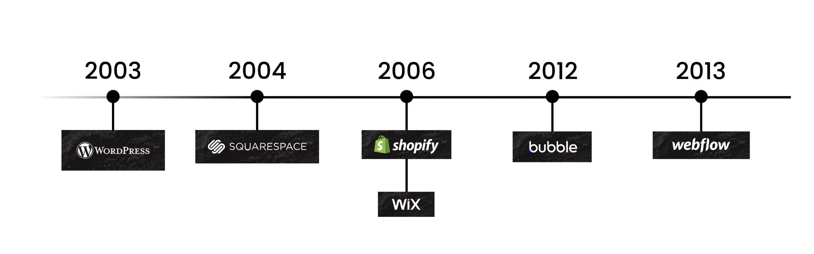
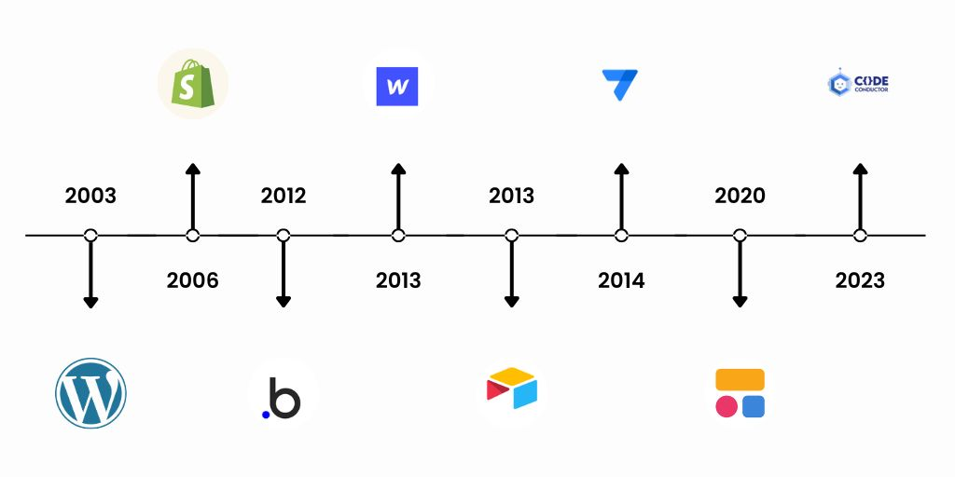
No-Code - Historic view
In summary, the history of no-code and low-code development reflects a significant evolution in how applications are built, moving from complex coding requirements to accessible, user-friendly platforms that empower a diverse range of users to create and innovate.
References:
https://kissflow.com/low-code/history-of-low-code-development-platforms/
https://www.smartsuite.com/blog/history-no-code-low-code-products
https://resources.formstack.com/reports/rise-of-the-no-code-economy/history
https://devtorium.com/blog/no-code-low-code-origins/

Slide 4
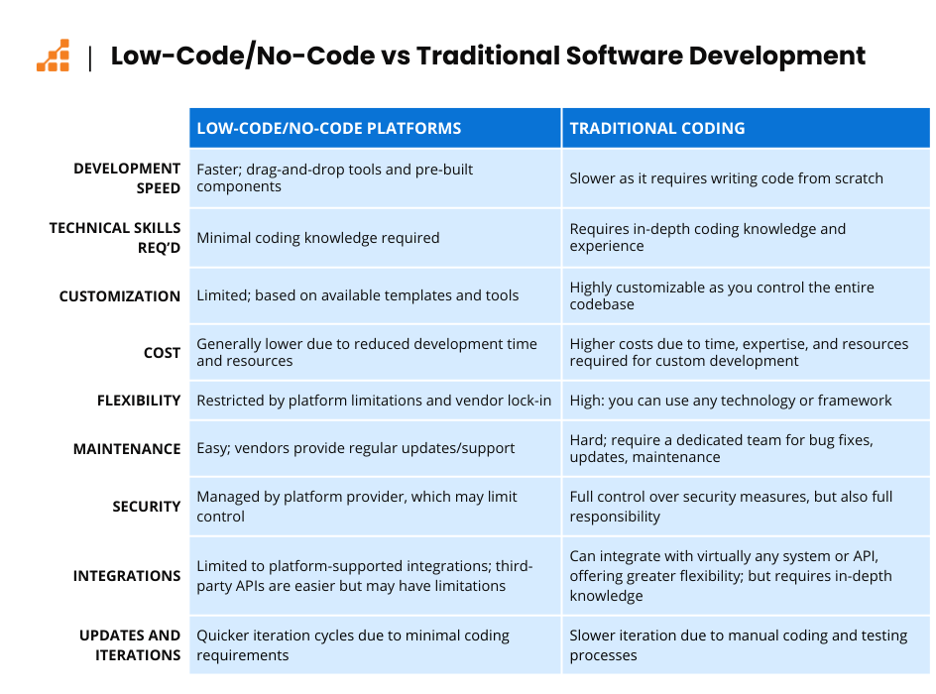
No-Code COMPARATIVE ANALYSIS
References:
https://dev.to/cloudestersoftware/no-code-vs-full-code-who-wins-in-2025-f02
https://www.airdev.co/post/full-code-vs-no-code-when-to-build-bubble-app
https://belighted.com/blog/no-code-vs-full-code
https://www.trootech.com/blog/code-no-code-app-guide-2025
Kindly Note:
“Traditional Development”/“Detail Code”, need a lot of energy and mind sensitive logic development personality. Consistent hard work and dedicated commitment, is needed for results in “Detail Code”. Mind alertness and sharpness, level is not same for each resource.
“No-Code”, is not hard core efforts path. It works with light personalities. It make sense for even not so sharp minded resources. It need a different light creative mindset. Even “Aged professional” can continue with “No-Code”/”Low Code” development, as it doesn’t require intense – mind energy and logic development fuel. Let’s start with “No-Code”/”Low Code” course path to achieve professional excellence and business success with agility. Let’s start Now. Thanks.

Slide 5
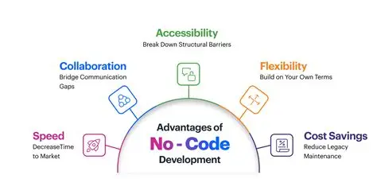
WHY – NO-CODE DEVELOPMENT - Advantages
The fundamental strategic advantage of embracing No-Code Development lies in its unprecedented ability to rapidly accelerate organizational agility by democratizing software creation and drastically lowering the barrier to entry for innovation. By utilizing visual interfaces and drag-and-drop tools, No-Code platforms empower business domain experts—the people who actually understand the process problem—to build and iterate custom applications and automations in hours or days, bypassing the traditional bottlenecks of relying solely on scarce IT or engineering resources. This speed of deployment, coupled with the inherent reduction in long-term maintenance costs and the ability to instantly test and refine Minimum Viable Products (MVPs), makes No-Code a powerful tool for driving bottom-up digital transformation and ensuring the business can pivot quickly in response to market demands.
Kindly note: All these product(s) have free tier as well as multiple price based tier. You can launch your professional career or personal business in free tier, when financial vaiablity- is here, you can move to next tier – with more and more features. Remember that, these products as solid client based and service provider partners ecosystem. If a client can pay good for these products, they can pay good for your professional services too. So pay, to earn as multiple times - is , way to go financial model. Remember, you can start with free tier to start with.
References:
https://northwest.education/insights/careers/5-pros-and-cons-of-no-code-development/
https://codeconductor.ai/blog/benefits-no-code-development/
https://quixy.com/blog/top-benefits-of-no-code-app-development/

Slide 6

Mindset for SUCCESS in LC/NC ECOSYSTEM
Problem-Solving & Analytical Thinking
Automation-First Mindset
Integration-Oriented Thinking
Design and User Experience Sensibility
Continuous Learning & Adaptability
Collaboration and Business Understanding
Creative Innovation
A future-ready No-Code/Low-Code developer is a creative problem solver and business innovator who blends logic, design, and automation to build smart digital solutions. With an automation-first mindset, they streamline workflows, connect systems, and deliver real business value without heavy coding.
Adaptable, curious, and user-focused, they think like builders, innovate like entrepreneurs, and learn like lifelong explorers — shaping the future of technology through simplicity and innovation.
References:
https://www.indium.tech/blog/top-10-skill-sets-for-low-code-developers
https://baserow.io/blog/no-code-low-code-best-practices

Slide 7
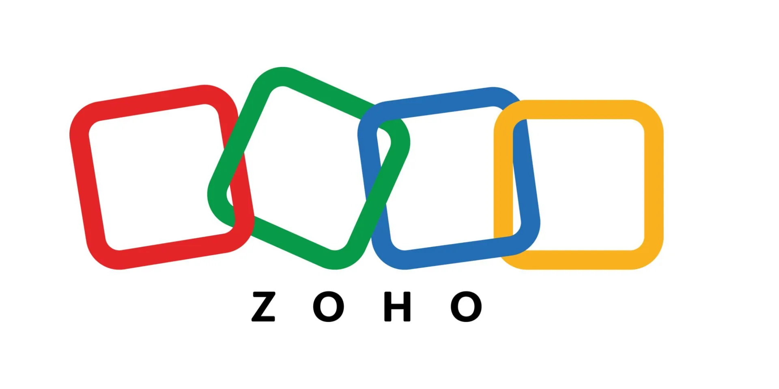
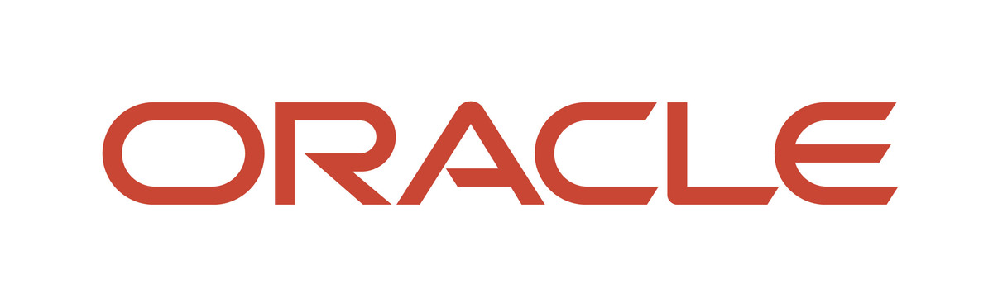
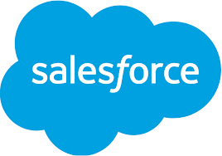
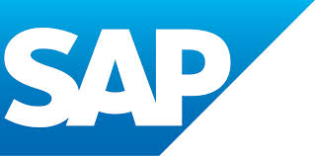

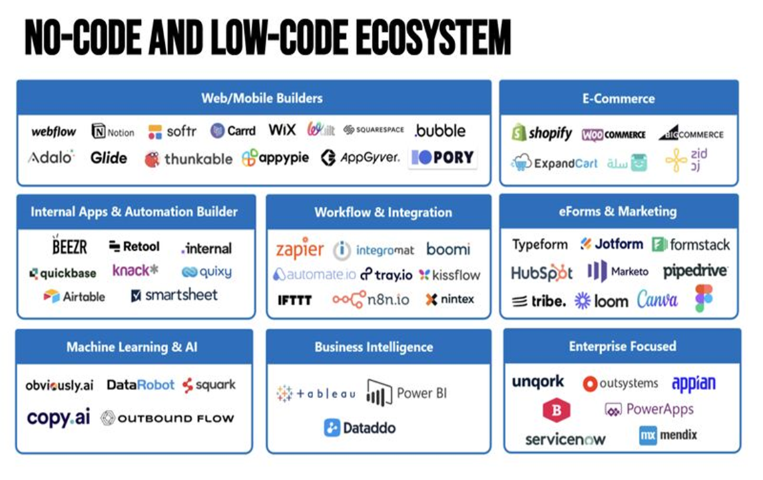
LC/NC DIRECTION–THE Software industry- outline
Zoho Creator is a low-code platform that allows users to build custom applications with minimal to no coding through its drag-and-drop interface, pre-built templates, and visual workflows.
https://www.zoho.com/creator
Oracle's primary "no-code" tool is Oracle APEX, a low-code development platform that allows for building applications with minimal
to no coding through visual, drag-and-drop interfaces.
https://apex.oracle.com/en
Salesforce provides several powerful tools designed for configuration without writing traditional code. [ Flow, Lightning App Builder ]
https://developer.salesforce.com/developer-centers/flow
https://www.salesforce.com/ap/platform/low-code-development-platform
SAP - Create business apps and automations with SAP Build - Develop apps and automations 3x faster using pro-code, low-code, and generative AI tools.
https://www.sap.com/mena/products/technology-platform/build.html
Google - AppSheet: Enable everyone in your organization to build and extend applications without coding.
https://cloud.google.com/appsheet
References:
https://pie-solutions.com/no-code/understanding-the-no-code-ecosystem-tools-and-trends/
https://dev.to/mehmetakar/low-code-no-code-platforms-346h
https://wpconnect.co/blog/nocode-lowcode-opensource-ecosystem/

Slide 8
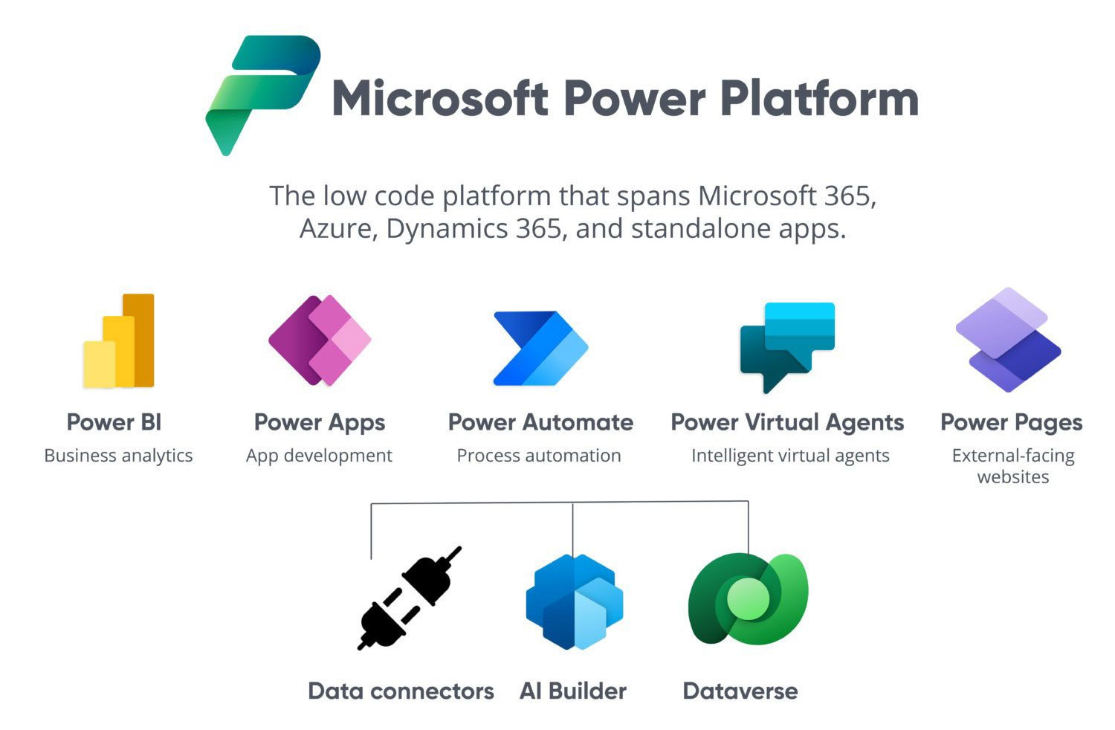
THE MICROSOFT WAY - NO CODE & LOW CODE
Microsoft Power Platform is a low-code platform designed to empower users to create custom business solutions, automate workflows, analyze data, and build websites. It integrates seamlessly with Microsoft services like Azure, Dynamics 365, and Microsoft 365.
Core Components of Power Platform
Power Apps: Enables the creation of custom applications using two approaches: Canvas Apps: Offers complete control over app design and allows integration with various data sources. Model-Driven Apps: Focuses on data-driven applications built on Microsoft Dataverse. Developers can extend functionality using custom UI components, connectors, and APIs.
Power Automate: Automates repetitive tasks and orchestrates workflows across services. Cloud Flows: Triggered by events or schedules. Desktop Flows: Automates tasks on desktops or web interfaces. Developers can create custom connectors and use workflow definition functions for complex logic.
Power BI: A business analytics tool for creating interactive data visualizations and sharing insights. Developers can embed Power BI into apps or websites and create custom visuals using its SDK.
Power Pages: A low-code platform for building secure, external-facing business websites. Developers can extend functionality using custom templates, APIs, and integration with Dataverse.
References:
https://www.microsoft.com/en-us/power-platform?msockid=2ec7dedc79d36ed91db7cd9078c76f83
https://en.wikipedia.org/wiki/Microsoft_Power_Platform
https://learn.microsoft.com/en-us/power-platform/

Slide 9


No-COde–Solutions/Services
[Covered in this Course]
https://zapier.com/
1. Zapier is a leading no-code AI orchestration platform that allows users to seamlessly connect over 8,000 different web applications to build powerful, custom workflows called "Zaps." It automates repetitive tasks between apps by defining a Trigger (when something happens) and an Action (what the system should do next), enabling non-technical users to save time and scale business processes. Fundamentally, Zapier acts as the central nervous system for your business, ensuring data moves precisely where and when it needs to go, without writing a single line of code.
https://n8n.io/
2. n8n is a powerful open-source workflow automation platform that allows users to connect various services, databases, and APIs to automate complex processes. It distinguishes itself by its self-hosted capability, giving users complete data sovereignty and control, while offering a graphical, node-based interface for visual programming. Functionally, n8n is designed for technical users and developers needing highly customized, private, and scalable backend automation that goes far beyond standard off-the-shelf integration tools.

Slide 10
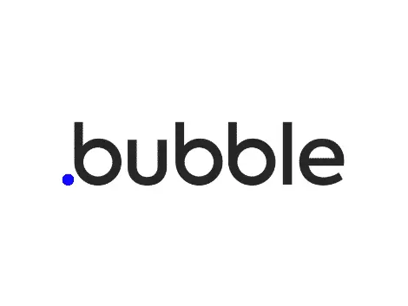
No-COde–Solutions/Services
[Covered in this Course] – Part - 2
https://bubble.io/
3. Bubble.io is a leading no-code visual programming platform that allows users to design, develop, and launch full-stack web and mobile applications without writing traditional code. It provides a drag-and-drop interface for building responsive front-end designs and a powerful workflow engine for complex back-end logic, database management, and API integrations. The platform serves as a complete development and hosting environment, making it the primary choice for entrepreneurs and non-technical founders to rapidly build, test, and scale their Minimum Viable Products (MVPs) and SaaS applications.
https://webflow.com
4. Webflow.com is a powerful visual web development platform that allows designers and marketers to create, launch, and host fully custom, responsive websites without needing to write traditional code. It translates visual design choices directly into clean, production-ready HTML, CSS, and JavaScript, offering a level of control typically reserved for expert coders. This blend of design freedom and technical rigor makes it the preferred tool for building high-fidelity marketing sites, portfolios, and blogs, complete with a robust built-in Content Management System (CMS).

Slide 11
No-Code Services Covered IN COURSE – Marketplace Ecosystem
Our Course - Tech companies Partners Ecosystem
WebFlow Certified Partners listing:
https://webflow.com/certified-partners/browse
“Bubble.io” Certified Partners listing:
https://bubble.io/experts-directory
Zapier Certified Partners listing:
https://zapier.com/partnerdirectory
The “n8n” Certified Partners listing:
https://experts.n8n.io/
This Course Students Possibilities - Potential Directions:
Types of Opportunities – Two Types of Companies
End Client Ecosystem [All sectors of industries like Real Estate, Construction, Education, Finance, Insurance, Tourism, Transport, etc.]
Service Provider Partner Ecosystem. [Rich Software Partners Industry ecosystem]
ACTION ITEMS - To DO:
Explore all partnership ecosystem, study their business model, investigate their financial-clients dynamics, brainstorm about their tech-stack implementation, evolve ideas about your future professional orientation to join these companies, strategize about your business road-map – to launch your company round these ideas, refine thought process.

Slide 12
No-Code – Web sites , App - Creation plus Build – with “Bubble.io” & “WebFlow”
Build full-featured web apps visually using Bubble.io, including databases, workflows, user authentication, and dynamic logic—without writing code.
Design professional, responsive websites with Webflow’s visual designer, offering pixel-perfect layout control and built-in SEO tools.
Launch faster with drag-and-drop components, pre-built templates, and reusable elements across both platforms.
Integrate APIs, automation, and third-party tools easily to extend functionality and create powerful digital experiences.
Deploy and scale instantly, allowing entrepreneurs, startups, and students to go from idea to live website or application in days instead of months.
ACTION ITEMS - To DO:
Explore all web sites, apps - creation & build possibilities, plan your professional orientation round these paths, strategize about your business road-map – to launch your company round these ideas, refine thought process.

Slide 13
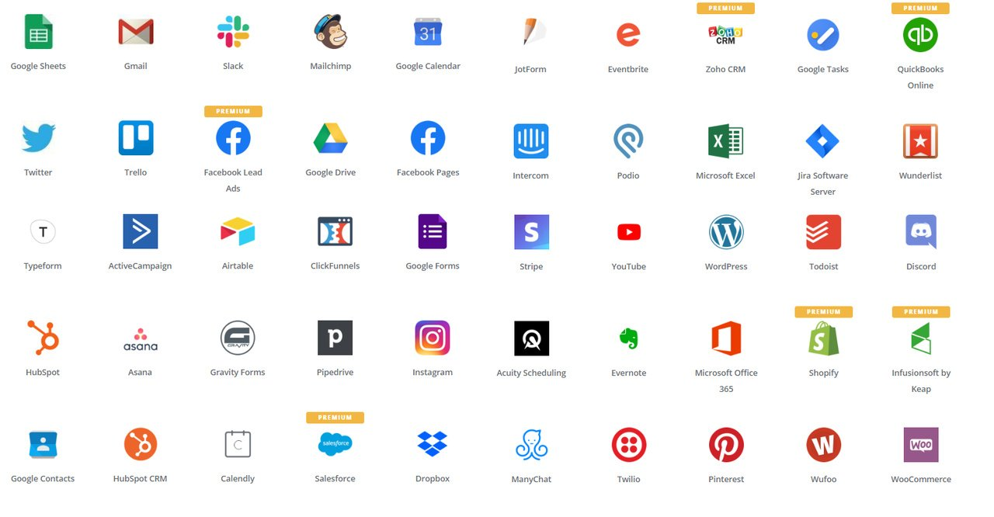
No-Code – Integration & Automation – Connected World
Zapier connects, 8000+ app(s) Ecosystem.
Explore your-self here:
https://zapier.com/apps
ACTION ITEMS - To DO:
Explore all 8000+ app integration possibilities, study their business automations, plan your professional orientation round these paths, strategize about your business road-map – to launch your company round these ideas, refine thought process.

Slide 14
Economy Challenges – & The SOLUTION & The Conclusion
In 2025, Pakistan's economy is showing signs of stabilization and modest recovery, but faces significant challenges including high poverty rates, persistent inflation, and structural issues like high public debt and low human capital investment.
Inflation: Inflation is easing, projected to bottom out at 6.0% in FY25, down significantly from 29% in 2023.
Public Debt: Public debt remains a concern, with external debt at approximately $131 billion.
Poverty and Crime: High poverty rates persist, with the World Bank noting that 60% of the population is below the poverty line, which is linked to an increasing crime rate.
In 2025, Pakistan faces significant poverty challenges, with the poverty headcount estimated at 44.7% under the World Bank's updated international threshold of $4.20 per day. Per Capita Income: Increased to an estimated $1,824 in FY2025, up 9.7% from the previous year.
[Source: World Bank Group - https://www.worldbank.org/ ]
The Solution:
Market size and growth
2025 - Current value: The overall IT and software outsourcing market is valued at approximately $613.69 billion. 2030 projection: One forecast predicts the market will reach $1.06 trillion by 2030, growing at a CAGR of 8.06% from 2022 to 2030.
The Conclusion:
The IT and software outsourcing market holds immense potential for economic empowerment, poverty alleviation, and social uplift, especially in developing countries. By enabling global companies to access skilled talent at competitive costs, outsourcing creates high-quality jobs, fuels entrepreneurship, and supports the growth of local digital ecosystems. It allows young professionals to earn globally while living locally, injecting foreign income into communities and strengthening local economies. Outsourcing reduces barriers to entry, empowering individuals from diverse backgrounds — including women, rural youth, and low-income groups — to participate in the global digital economy. As demand for IT services, cloud solutions, AI, automation, and no-code development increases worldwide, the outsourcing industry becomes a powerful engine for upward mobility, skills development, and long-term socio-economic transformation.

Slide 15
Course Monetization - Productized Service Offers – TAG LINES - USA & Europe Markets
Cross-Platform, High-Value Taglines (Zapier + n8n + Bubble + Webflow)
Automation + Apps + Website = Your Entire Digital System Built Off-Shore.
“One Partner for No-Code Apps, Automation & Web Presence.”
“Build Faster. Automate Faster. Grow Faster.”
“Your Off-Shore No-Code Tech Team for USA & Europe.”
“From Workflows to Websites — Delivered End-to-End.”
“No-Code Engineering for Lean, Global Teams.”
“Scale Your Business Without Scaling Your Costs.”
Zapier – Automation & Integration
Automate Your Business. Scale Without Hiring.
Zapier Workflows That Save Hours Every Day.
Turn Manual Tasks Into Automatic Profits.
Your On-Demand Zapier Automation Partner.
Smart Integrations for Fast-Growing US & EU Teams.
Zapier Systems that Run Your Business While You Sleep.
Plug, Play, Automate — Zero Engineering Needed.
“n8n” – Advanced Automation & Custom Workflows
Enterprise-Level Automations Without Enterprise Costs.
Flexible, Open-Source Automation Designed for Scale.
Custom n8n Workflows Built for Complex Operations.
Deep Integrations for Data-Driven Teams.
Supercharge Your Tech Stack with Visual Automation.
Automation Powerhouse for USA/EU Tech Companies.
“Bubble.io” – Web App MVPs & SaaS Prototypes
Build Your SaaS MVP 5× Faster — No Code.
From Idea to App — Delivered in Days, Not Months.
Bubble Apps That Look Great and Scale Fast.
Launch Your Product Without Developers.
Convert Business Ideas Into Fully Working Applications.
Bubble.io Development for Founders Who Need Speed.
“Webflow” – Websites, Landing Pages & Brand Experiences
Premium Webflow Websites That Convert Visitors to Clients.
Design. Develop. Launch — All in Webflow.
Fast, Beautiful Websites Built for Growth.
Webflow Sites Built for Speed, SEO & Scale.
Your Brand, Elevated with Webflow Design.
Pixel-Perfect, No-Code Websites for US/EU Businesses.
Modern Web Experiences Without Being a Developer.
Launch High-Impact Marketing Sites in Days.

Slide 16
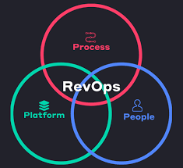
Revenue Operations , “Rev-Ops” – The Future
Revenue Operations (RevOps) is a strategic business function that aligns and optimizes all revenue-generating activities and departments—specifically marketing, sales, and customer success—to drive efficient and predictable growth.
RevOps serves as the central nervous system for a business, aiming to break down traditional departmental silos by unifying processes, data, and technology across the entire customer lifecycle, from initial lead generation to post-sale retention and expansion.
What - Why in this course?
There is no single "no code" for "revenue operations" because revenue operations (RevOps) is a professional function, not a single piece of software. However, many RevOps professionals use low-code or no-code tools to automate workflows and connect different systems, which helps them overcome the limitations of a manually-integrated tech stack, which is often necessary because they aren't typically software engineers themselves. RevOps is a function, not a product.
The adoption of a dedicated RevOps function has increased significantly, from 33% of companies in 2020 to 48% in 2024, with predictions that 75% of high-growth companies will adopt this model by 2025. This growth is reflected in the job market, with over 174,000 RevOps job postings found on ZipRecruiter in mid-2024. The revenue operations software market alone was valued at $3.71 billion in 2023 and is projected to reach $15.9 billion by 2033, demonstrating substantial investment in the field. Companies with aligned processes and technology due to RevOps have shown significant revenue growth and profitability.
References:
https://www.salesforce.com/ap/sales/revenue-lifecycle-management/what-is-revenue-operations/ https://www.cognism.com/blog/revenue-operations
https://www.revenueoperationsalliance.com/what-is-revenue-operations-revops/

Slide 17
Career Opportunities/Roles/Positions - in the No-Code / Low-Code Space - USA & Europe Markets
Automation & Integration Careers (Zapier, n8n)
Automation Specialist / Workflow Engineer – designing business automations for startups and SMEs.
App Integration Consultant – connecting SaaS tools for global clients (CRM, marketing, HR, finance).
Operations Automation Manager – optimizing internal processes for efficiency.
Data Pipeline Builder (No-Code) – connecting apps, syncing platforms, and handling ETL tasks.
Freelance Automation Expert for USA & Europe – offering productized automation services.
Web & App Development Careers (Bubble.io, Webflow)
No-Code Web App Developer (Bubble) – building marketplaces, SaaS MVPs, dashboards.
Product Prototyper / MVP Builder – rapid app creation for founders and startups.
Webflow Designer / Developer – building professional websites, landing pages, and brand experiences.
Mobile App Creator (No-Code) – developing apps without coding using modern no-code platforms.
Startup Builder / Technical Co-Founder – providing technical execution using no-code tools.
Business, CRM & Operations (HubSpot, Airtable, Monday.com)
CRM Implementation Consultant – setting up HubSpot, Zoho, or Pipedrive systems using no-code.
Business Automation Analyst – mapping business processes and building digital workflows.
Airtable/Notion System Architect – building internal tools, databases, and dashboards.
RevOps (Revenue Operations) Specialist – improving sales, marketing, and support processes with automation.
Design, UX, and Digital Experience (Webflow, Figma)
No-Code UI/UX Designer – designing user-friendly web app layouts.
CMS & Content Systems Specialist – building content-rich Webflow sites for global brands.
Digital Experience Builder – creating interactive sites, microsites, and onboarding experiences.
Entrepreneurship, Freelancing, and Off-Shore Services
Freelance No-Code Developer – serving US & EU clients remotely.
Creator of Productized Services – selling ready-made automation/web packages.
No-Code Startup Founder – launching products without needing a technical team.
Remote Consultant for SMEs – providing scalable solutions at low cost.
Agency Owner (Automation + Web + Apps)– building a multi-tool no-code service model.

Slide 18
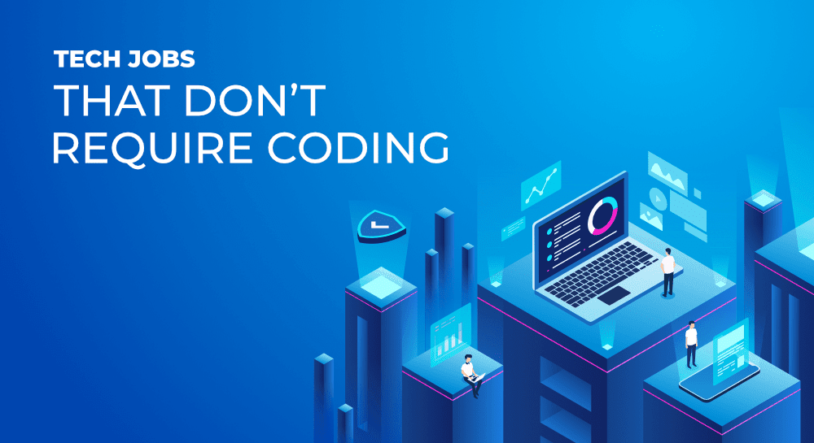
NO CODE & LOW CODE – Career Orientation
The rise of no-code technology is transforming the way we think about digital creation. No longer is app development or workflow automation limited to traditional coders; no-code platforms empower anyone to build sophisticated digital tools and solutions without needing programming skills.
References:
https://www.nocodeinstitute.io/post/what-jobs-can-you-get-with-no-code-skills
https://www.ziddu.com/five-no-code-tech-careers-you-can-pursue/
https://markaicode.com/no-code-development-career-paths-2025/
https://zerocodeinstitute.com/career-opportunities-with-no-code-skills/
https://www.findcareerinfo.com/no-code-career-paths/

Slide 19
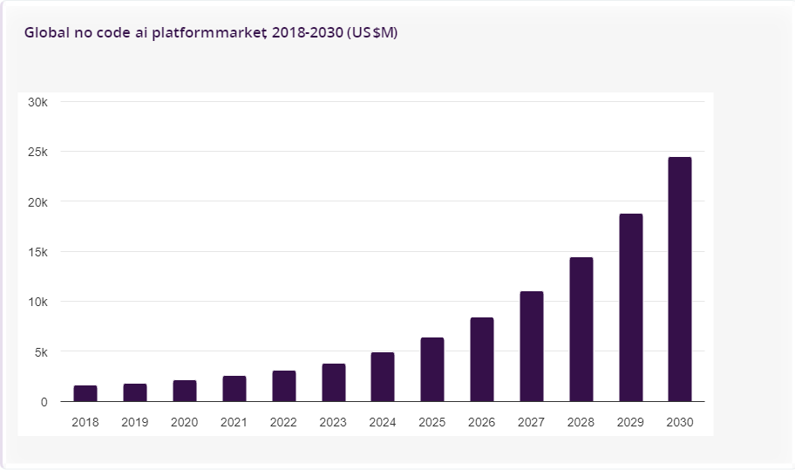
NO CODE & LOW CODE – Market Share Size
Current : $35.61 billion
Future : $86.55 billion by 2029
The no-code development platforms market size has grown exponentially in recent years. It will grow from $28.11 billion in 2024 to $35.61 billion in 2025 at a compound annual growth rate (CAGR) of 26.7%.
Expected to grow to $86.55 billion in 2029 at a compound annual growth rate (CAGR) of 24.9%
References:
https://www.thebusinessresearchcompany.com/report/no-code-development-platforms-global-market-report
https://codeconductor.ai/blog/no-code-statistics/
https://wpconnect.co/blog/nocode-lowcode-opensource-ecosystem/

Slide 20
NO-CODE & LOW-CODE - Industry Trends
KPMG International Limited - References: https://kpmg.com/xx/en/our-insights/transformation/how-low-code-platforms-are-driving-digital-transformation.html
Hostinger No-Code Insight:
https://www.hostinger.com/tutorials/low-code-trends
GeekForGeeks No-Code Insights:
https://www.geeksforgeeks.org/blogs/low-code-trends/
ScaleupAlly - Admito Technologies -
https://scaleupally.io/blog/low-code-trends/

Slide 21
Why Join - our No-Code/Low-Code Training Course
Are you ready to turn your ideas into real projects — without writing a single line of code?
Join our No-Code/Low-Code Training Course and learn how to build professional websites, web apps, and smart automations using powerful tools like Webflow, Bubble, Zapier, and n8n.
Here’s why you should join:
💡 Learn future-ready skills — No-code and low-code platforms are in high demand worldwide.
🌐 Create real projects — Build stunning websites with Webflow and full-function web apps with Bubble.
⚙️ Automate your workflows — Use Zapier and n8n to connect apps and save hours of manual work.
🧠 Boost creativity & independence — Prototype, launch, and scale your own ideas without waiting for developers.
📈 Enhance your career opportunities — Whether you’re a student, freelancer, or aspiring entrepreneur, these tools give you a competitive edge.
Start building smarter — not harder.
👉 Enroll now and become part of the next generation of digital creators!

Slide 22
No-Code/Low-Code TRACK - RESOURCES FOR SELF STUDY
Books - Some recommended titles include
“No Code: A Guide to Building World-Class Products Without Writing a Single Line of Code” by Ryan Hoover
“The No-Code Startup” by Bram Kanstein.
Some more books recommendations:
https://joelbooks.com/best-books-on-no-code-development-platforms/
Some more resources:
https://medium.com/@rkozlowski91/top-26-no-code-resources-for-2024-d5a150eae98b
Blog: https://nocodedev.com/blog/
Events: https://citizendevelopmentweek.com/
No-code Influencers You Need To Follow Immediately
https://www.involve.me/blog/no-code-influencers
More to read:
https://www.sap.com/mena/products/technology-platform/build/what-is-low-code-no-code.html
https://www.ey.com/en_us/alliances/low-code-no-code-platforms-and-a-culture-of-innovation
https://www.oracle.com/application-development/low-code/
https://cloud.google.com/discover/what-is-low-code?hl=en tps://www.oracle.com/application-development/low-code/
https://www.geeksforgeeks.org/blogs/low-code-trends/
https://www.salesforce.com/platform/low-code-development-platform/what-is-low-code/low-code-vs-no-code/
https://www.salesforce.com/platform/low-code-development-platform/what-is-no-code/
https://www.salesforce.com/ap/platform/low-code-development-platform/what-is-low-code/

Slide 23

Thanks for your time
Thank you - for listening and participating
ACTION ITEMS - To DO:
Explore all 4 products [ Zapier, n8n, bubble.io , webflow ] - ecosystem
Study their business model, investigate their financial-clients dynamics
Brainstorm about their tech-stack implementation
Evolve ideas about your future professional orientation to join these companies or their huge service provider partners ecosystem or their client based directly.
Strategize about your business road-map – to launch your company round these ideas, refine thought process.
Let’s plan for take-off with this course.
Questions / Queries
Suggestions/Recommendation
Ideas…..?
Shahzad Sarwar
Cognitive Convergence
https://cognitiveconvergence.com

